Slide 1




Proposal for The Shift Wave Company
We are excited to present our proposal, aiming to connect university students with local organizations for internships and volunteering, bridging the gap between academia and practical experience.
by Mich Michira

Slide 2
Mission & Vision
Mission
Vision
Empower students to navigate the internship process and secure opportunities that enhance professional development.
To be the leading online platform for internship seekers, simplifying the search process and empowering professionals.

Slide 3

Goals
1
Personalize
2
Simplify
Personalize the internship search with advanced algorithms for tailored recommendations.
Develop a user-friendly platform for easy resume creation and internship applications.
3
Expand
Continuously update the internship database for diverse opportunities.

Slide 4
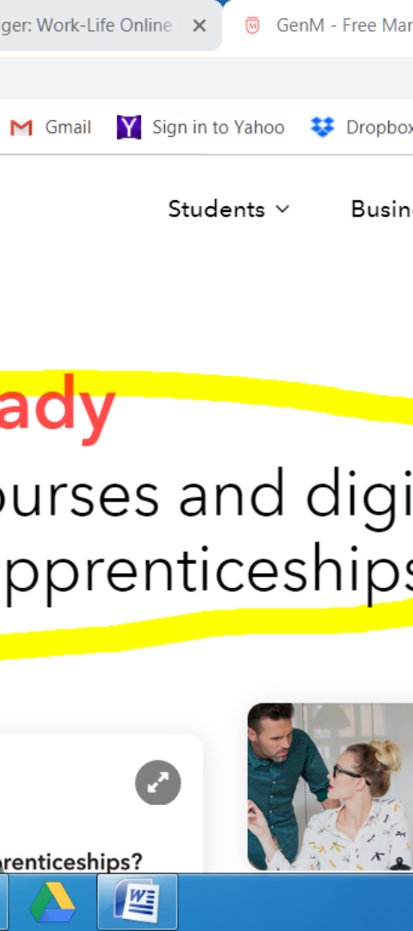
Key Features
1
Resume Builder
A user-friendly interface for creating a professional resume.
2
Internship Database
A comprehensive database of diverse internship opportunities.
3
Matching Algorithm
An algorithm to match students with suitable internship programs.

Slide 5
Target Audience
Campus Students
Educational Institutions
Employers
Students seeking internships to gain practical experience and skills.
Organizations offering internships and seeking qualified candidates.
Institutions interested in supporting students in their internship search.

Slide 6




Marketing Strategy
Social Media
Engage with the audience on platforms like Facebook and LinkedIn.
Partnerships
Collaborate with institutions and organizations to promote our services.
Content Marketing
Create valuable content for internship seekers.

Slide 7
Revenue Model
2
1
Freemium
Sponsored
Basic access for free, premium features for a fee.
Employers can sponsor listings for increased visibility.

Slide 8

Timeline & Conclusion
1
Months 1-2
Development and testing of the platform.
2
Months 3-6
Content creation, marketing, and launch of The Shift Wave.
3
Months 7-12
Growth, expansion, and continuous platform improvement.
The Shift Wave Company is set to revolutionize the internship application process, promising a brighter future for students and professionals.

